Slide 1


Slide 2

Business Understanding - Problem Statement
3.24x
4–5x
Actual ROAS
Target ROAS
📉 ROAS Below Target
💸 Budget Being Wasted
Stuck at 3.24x vs 4–5x goal.
No one knew why it wasn't hitting.
$16,195/month on losing
campaigns — silently draining ROI.
🔍 No Campaign Visibility
🎯 No Audience Insight
20 campaigns, no single view
of profit vs loss per campaign.
Zero data on which loan segment
or audience converted best.

Slide 3
RAW DATA
Data Understanding
Google Ads
Facebook Ads
TikTok Ads
↓ Merged into one Master Sheet
Master Sheet Columns (A → X)
EMAIL | firstname | lastname | city | state | salary | employer
campaign_name | platform | Date | loan_amount | impressions | clicks
conversions | cost | revenue | ROAS | Profit | ROI% | CTR | CPC | CPA | Conv% | Status

Slide 4
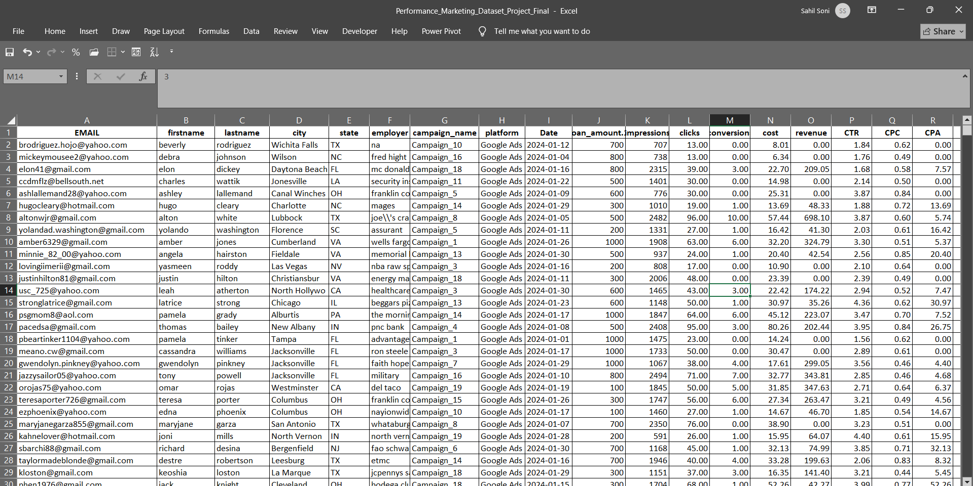
Raw Data

Slide 5
DATA CLEANING
Data Cleaning - What I Fixed Before Any Formula
01
Currency symbols in numbers
02
Blank Revenue cells
=VALUE(SUBSTITUTE(B2,"$",""))
=IF(F2="","CHECK","OK")
03
Duplicate rows
04
Inconsistent campaign names
Data → Remove Duplicates
=TRIM(PROPER(SUBSTITUTE(A2,"_"," ")))
05
Summary rows in raw data
06
Validated platform totals
Scrolled to bottom → deleted Total row
=SUMIF(I:I,"Google Ads",O:O)

Slide 6
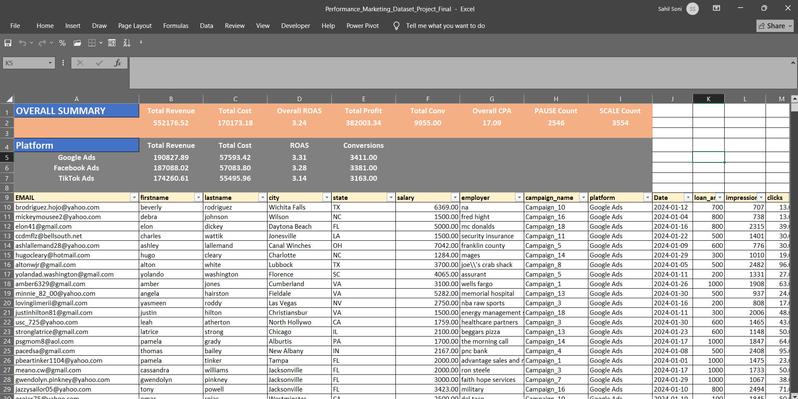
MASTER_SHEET

Slide 7
KPI - CALCULATION
8 KPIs Calculated with Excel Formulas
ROAS
3.24x avg
Profit
$382,003
=IFERROR(G2/E2, 0)
=G2 - E2
ROI %
224.48%
CTR %
Varies
=IFERROR((G2-E2)/E2*100, 0)
=IFERROR(D2/C2*100, 0)
CPC
Per click
CPA
Per lead
=IFERROR(E2/D2, 0)
=IFERROR(E2/F2, 0)
Conv Rate %
Varies
Status Flag
Auto assign
=IFERROR(F2/D2*100, 0)
=IF(H2>=3.5,"SCALE",IF(H2>=3,"MONITOR",IF(H2>=2.5,"OPTIMISE","PAUSE")))

Slide 8
PIVOT TABLES
Data Structure - 3 Pivot Tables — One per Client Question
PT_Campaign
Which campaign to scale or pause?
ROWS: campaign_name | VALUES: Revenue · Cost · Conversions · Profit · ROAS
→ Campaign_1 = best (3.76x) · Campaign_20 = worst (2.56x)
PT_Platform
Which platform gives best ROI?
ROWS: platform | VALUES: Revenue · Cost · Conversions · Clicks
→ Facebook led 39.4% revenue share · TikTok lowest
PT_LoanAmt
Which audience segment converts best?
ROWS: Loan_Bucket | VALUES: Revenue · Cost · Conversions · ROAS
→ High (501–750) = 3,300 conversions — best segment

Slide 9
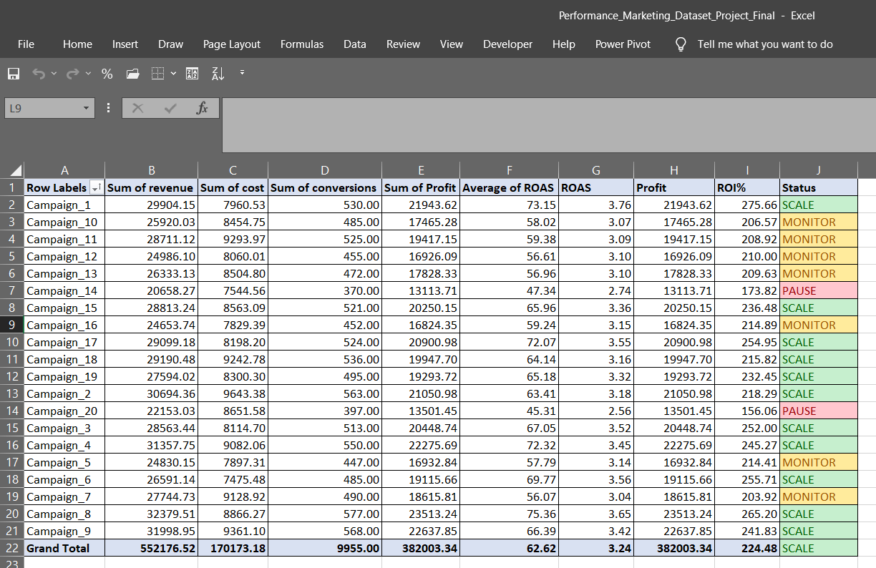
PT_Campaign

Slide 10
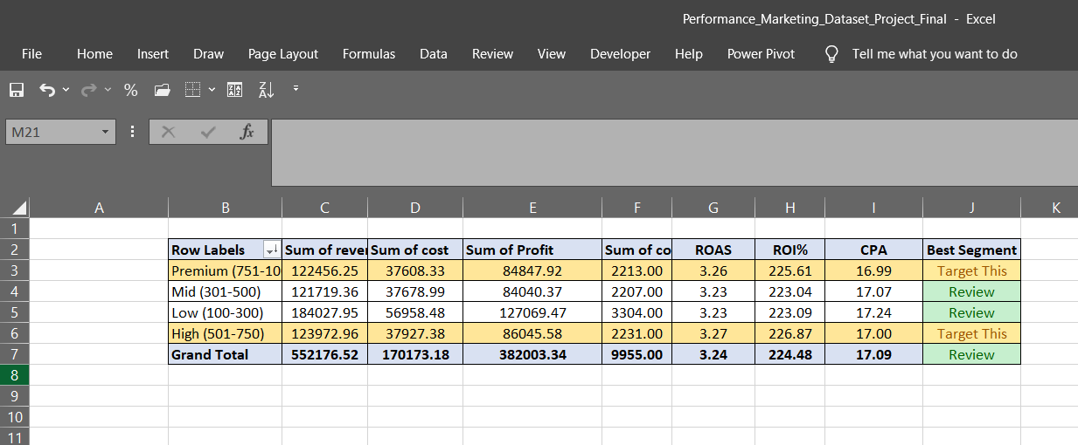
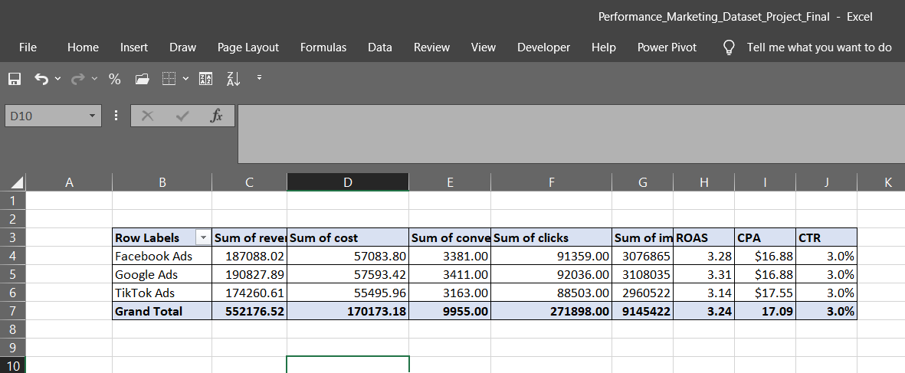
PT_Loan_Amount
PT_Platform

Slide 11
KEY INSIGHTS
EDA & Segmentation - What the Data Revealed
TOP 5 CAMPAIGNS
WORST 5 CAMPAIGNS
1. Campaign_1
3.76x
1. Campaign_20
2.56x
2. Campaign_8
3.65x
2. Campaign_14
2.74x
3. Campaign_6
3.56x
3. Campaign_7
3.04x
4. Campaign_17
3.55x
4. Campaign_10
3.07x
5. Campaign_3
3.52x
5. Campaign_11
3.09x
📊 Overall ROAS 3.24x — 0.76x gap from 4x client target
📱 Facebook Ads led with 39.4% revenue share across all platforms
🎯 High loan segment (501–750) = 3,300 conversions — best audience

Slide 12
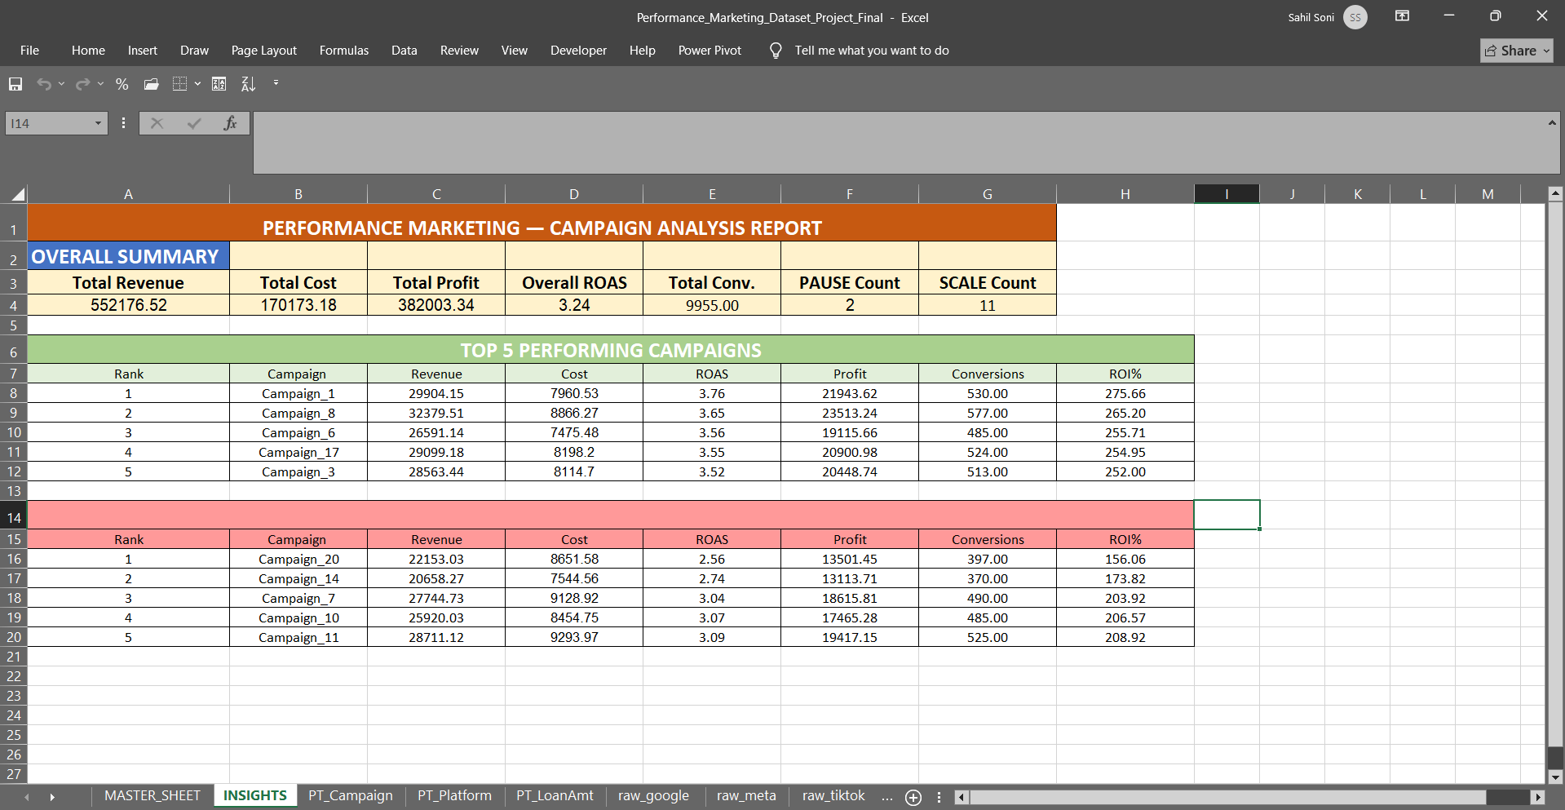
INSIGHTS

Slide 13
ACTION PLAN
From Insights to Business Decisions
❌ PAUSE
🚀 SCALE
📈 RESULT
Campaign_20 — ROAS 2.56x
Campaign_1 — ROAS 3.76x
Current ROAS: 3.24x
Campaign_14 — ROAS 2.74x
Campaign_8 — ROAS 3.65x
Projected ROAS: 4x+
Campaign_6 — ROAS 3.56x
Combined waste:
Timeline: 30 days
$16,195 / month
Budget increase:
Monthly saving: $16,195
+25% on top 2
Action: Stop today
+15% on Camp_6
Best audience:
Reallocate to winners
Add $16K saved
High loan (501–750)

Slide 14
POWER BI DASHBOARD
From Excel Data to Interactive Dashboard
$552,177
$170,173
3.24x
$382,003
9,955
Total Revenue
Total Cost
Overall ROAS
Total Profit
Conversions
Track overall performance in one view
Compare campaign efficiency instantly
Identify high vs low ROI campaigns
Analyze platform contribution
From data to decisions — see the dashboard in the next post

